Slide 1

Note: The data and information in this document is reflective of a hypothetical situation and client. This document is to be used for KPMG Virtual Internship purposes only.
Sprocket Central Pty Ltd
Data analytics approach
KPMG Virtual Internship - LiHui HAN

Slide 2
Note: The data and information in this document is reflective of a hypothetical situation and client. This document is to be used for KPMG Virtual Internship purposes only.
Agenda
Introduction
Data Exploration
Model Development
Interpretation

Slide 3
Introduction
The goal of our task
Outline of problem
Sprocket Central is a company that specializes in high quality bike and accessories.
The Marketing Team is looking to boost sales.
To target 1000 new customers that will bring the highest value to the business.
Approach for Data Analysis
Age Distributions of ‘New’ and ‘Old’ Customers
Number of Bike Purchases in 3 years by Gender
Job industry Distributions
Wealth segmentation by Age Category
Car Ownership by State
New Customers Lists
(Without transaction data)
Input
Model
Train
Existing Customer Data
&
Transactions Data
Predict
Identify High Value Customers

Slide 4
Introduction
Data Quality Assessment & Data Cleaning
 | Customer Demographic | Customer Addresses | Transaction Data
Accuracy | DOB: Inaccuracy Age: Missing |  | Profit: Missing
Completeness | Customer IDs: Incomplete DOB: Blanks Job Title: Blanks Tenure: Blanks | Customer IDs: Incomplete | Customer IDs: Incomplete Brand: Blanks Online Order: Blanks
Consistency | Gender: Inconsistency | States: Inconsistency
Currency | Deceased Customers: Filter Out
Relevancy | Default: Exclude Field |  | Order Status: Exclude Cancelled
Validity |  |  | Product First Sold Date: Format
Records with Missing Fields were Dropped.
Join Keys between Tables were considered and conflicting Records were Dropped.
Age, Last Purchase (Days Ago) and Profit Fields were Added.
Records pertaining to Deceased Customers were Dropped.
Transactions more than a year old were Dropped.

Slide 5
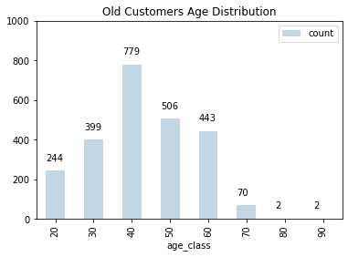
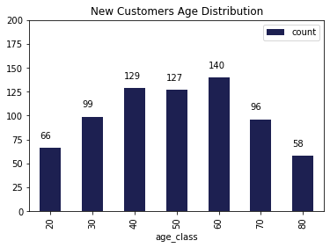
Note: The data and information in this document is reflective of a hypothetical situation and client. This document is to be used for KPMG Virtual Internship purposes only.
Data Exploration
Customer Age Distribution
The lowest age groups are 20 and 80+ for both datasets
As we can see, majority of old customers are between 40 age group while new customers are between 40 – 60 age group.
There is a steep drop of customers in the 50-age group.
There are more new customers in the 80-age group compared to old customer list.

Slide 6
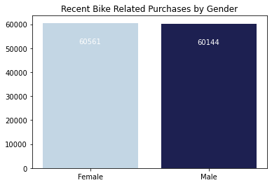
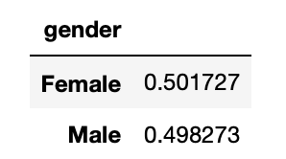
Note: The data and information in this document is reflective of a hypothetical situation and client. This document is to be used for KPMG Virtual Internship purposes only.
Data Exploration
Bike Related Transactions over the Past 3 Years by Gender
Nearly 50% of the bike related transactions in the last 3 years were made by female and 49% purchases were made by male.
We can focus on advertises on Female customers as they made up majority of bike related sales.
Percentage

Slide 7
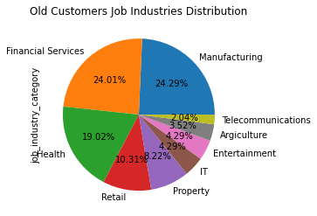
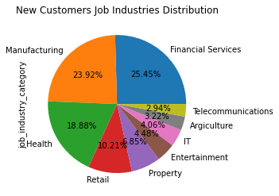
Note: The data and information in this document is reflective of a hypothetical situation and client. This document is to be used for KPMG Virtual Internship purposes only.
Data Exploration
Job Industry Distribution
Manufacturing and Financial Services industries are the most popular job industries among our customers.
The least number of customers are in Agriculture and Telecommunications at 3%
The job industry distribution pattern for both datasets is similar.

Slide 8
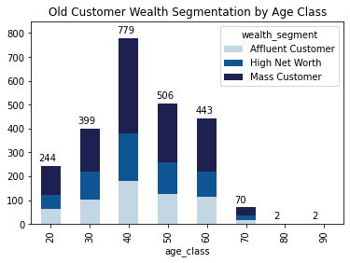
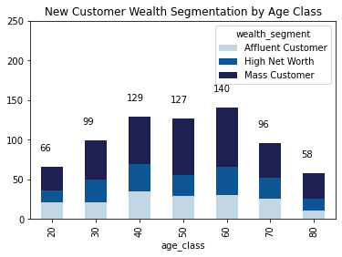
Note: The data and information in this document is reflective of a hypothetical situation and client. This document is to be used for KPMG Virtual Internship purposes only.
Data Exploration
Wealth Segmentation by Age Class
Overall, the Mass Customer Segmentation makes the highest profit across different age clusters.
The Mass Customer aged between 35-44 are likely to bring more profit for the company compared to other age clusters.
This also indicates a trend of buying power, as the buying power increases over time till 50 and then see’s a decline in buying power, thus leading to lower profits.

Slide 9
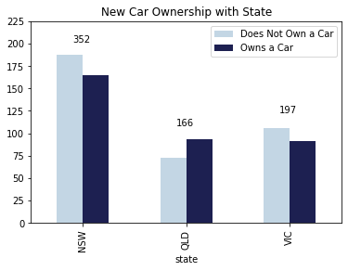
Note: The data and information in this document is reflective of a hypothetical situation and client. This document is to be used for KPMG Virtual Internship purposes only.
Data Exploration
Car Ownership by State
NSW and VIC should be considered the most since numbers of customers don’t own cars is significantly larger than that own.
QLD has relatively high number of customers that own a car.

Slide 10
Note: The data and information in this document is reflective of a hypothetical situation and client. This document is to be used for KPMG Virtual Internship purposes only.
Model Development
Customer Segmentation and RFM Analysis
RFM Analysis is a marketing analysis tool used to identify a firm's best clients based on the nature of their spending habits.
An RFM analysis evaluates clients and customers by scoring them in three categories:
Customers are distributed into 12 class based on RFM Score System.
Segment | RFM Score
Platinum | 3
Very Loyal | 4
Becoming Loyal | 5
Recent | 6
Average | 7
High Risk | 8
Evasive | 9
Losing | 10
Inactive | 11
Lost | 12
Recency : How recently they've made a purchase,
Frequency: How often they buy,
Monetary Value : The size of their purchases.
Source: Investopedia

Slide 11
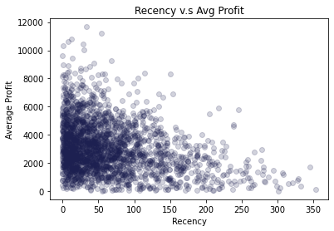
Note: The data and information in this document is reflective of a hypothetical situation and client. This document is to be used for KPMG Virtual Internship purposes only.
Model Development
Scatter Plot of RFM Model – Recency Against Monetary Value
Scatter plot shows positive relationship between recency and average profit generated.
The graph shows that customers who made a purchases more recent have generate more profit.

Slide 12
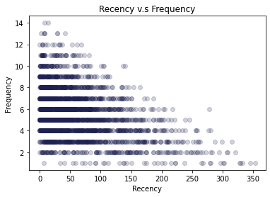
Note: The data and information in this document is reflective of a hypothetical situation and client. This document is to be used for KPMG Virtual Internship purposes only.
Model Development
Scatter Plot of RFM Model – Recency Against Frequency
There are negative correlation between recency and frequency score, indicated that customers who visited more recent have higher chance to visit more frequent.
Very frequent customer (14) are also very recent customer (0-50).

Slide 13
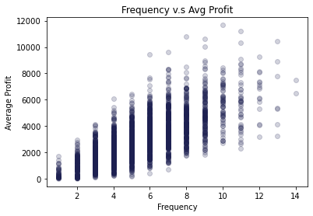
Note: The data and information in this document is reflective of a hypothetical situation and client. This document is to be used for KPMG Virtual Internship purposes only.
Model Development
Scatter Plot of RFM Model – Frequency Against Monetary Value
There is a positive relationship between these two indicators.
Customers tend to increase the average revenue of the business as they visit more frequent.

Slide 14
Note: The data and information in this document is reflective of a hypothetical situation and client. This document is to be used for KPMG Virtual Internship purposes only.
Interpretation
Customer Targeting Methodology
Segment | RFM Score | Cumulative
Platinum | 3 | 117
Very Loyal | 4 | 327
Becoming Loyal | 5 | 582
Recent | 6 | 890
Average | 7 | 1210
High Risk | 8 | 1488
Evasive | 9 | 1776
Losing | 10 | 2022
Inactive | 11 | 2227
Lost | 12 | 2445
Customers having high RFM Scores can be filtered and targeted.
The customers have made recent purchases, are frequent, and drive the most profits.

Slide 15
Note: The data and information in this document is reflective of a hypothetical situation and client. This document is to be used for KPMG Virtual Internship purposes only.
Appendix

Slide 16
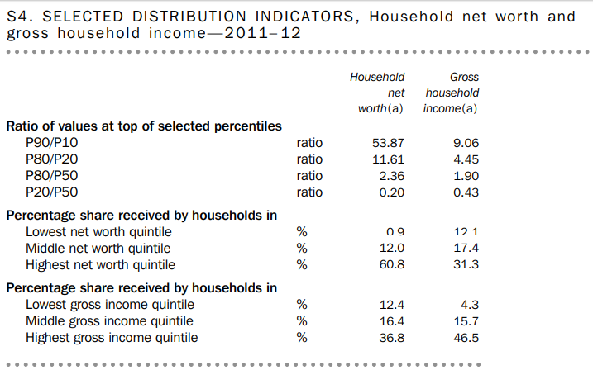
Note: The data and information in this document is reflective of a hypothetical situation and client. This document is to be used for KPMG Virtual Internship purposes only.
Appendix

